Slide 1
Payment Billing System
Submitted by-
Yashovardhan Singh
Nupur Goyal
Mumtaz Uddin
Shreya Khandelwal

Slide 2
Introduction
We are developing a website which provides a payment gateway
It will be easier to make and receive payments for an organisation
An accountant will be provided with special administrator rights
Only accountant can make changes in details

Slide 3
Abstract
In the existing system only we can see the details of particular information about the particular employee’s account details , the existing system has more workload for the authorized person, but in the case of Proposed System, the user can registered in our site and check for their account details and the accountant who is also the only authorised person to edit the information can access and edit those details online sitting at one place

Slide 4
Objective
Information retrieval will be become easy
Maintenance of database as well as overall project will become easy
Security measure will be adopted by maintaining the login of username and password
Data redundancy will be greatly reduced
To reduce the delay in bill generation

Slide 5
Problem Statement
In existing system all the work is done manually
Lack of authentication mechanism in existing system.
Existing system do not provide role based access.

Slide 7
Drawbacks of Existing System
More man power.
Time consuming.
Consumes large volume of paper work.
Needs manual calculations.
No direct role for the higher officials.
More scope for errors

Slide 8
Advantages of proposed system
Ensure data accuracy’s.
Proper control of the higher officials.
Minimize manual data entry.
Minimum time needed for the various processing.
Greater efficiency.
Better service.
User friendliness and interactive.
Minimum time required.

Slide 9
Scope
In future we can use photo re organisation instead of using heterogeneous database.
Ensurity of High speed and accuracy of data.
More controlled and error free handling of account details
This system can be further expanded on larger levels

Slide 10
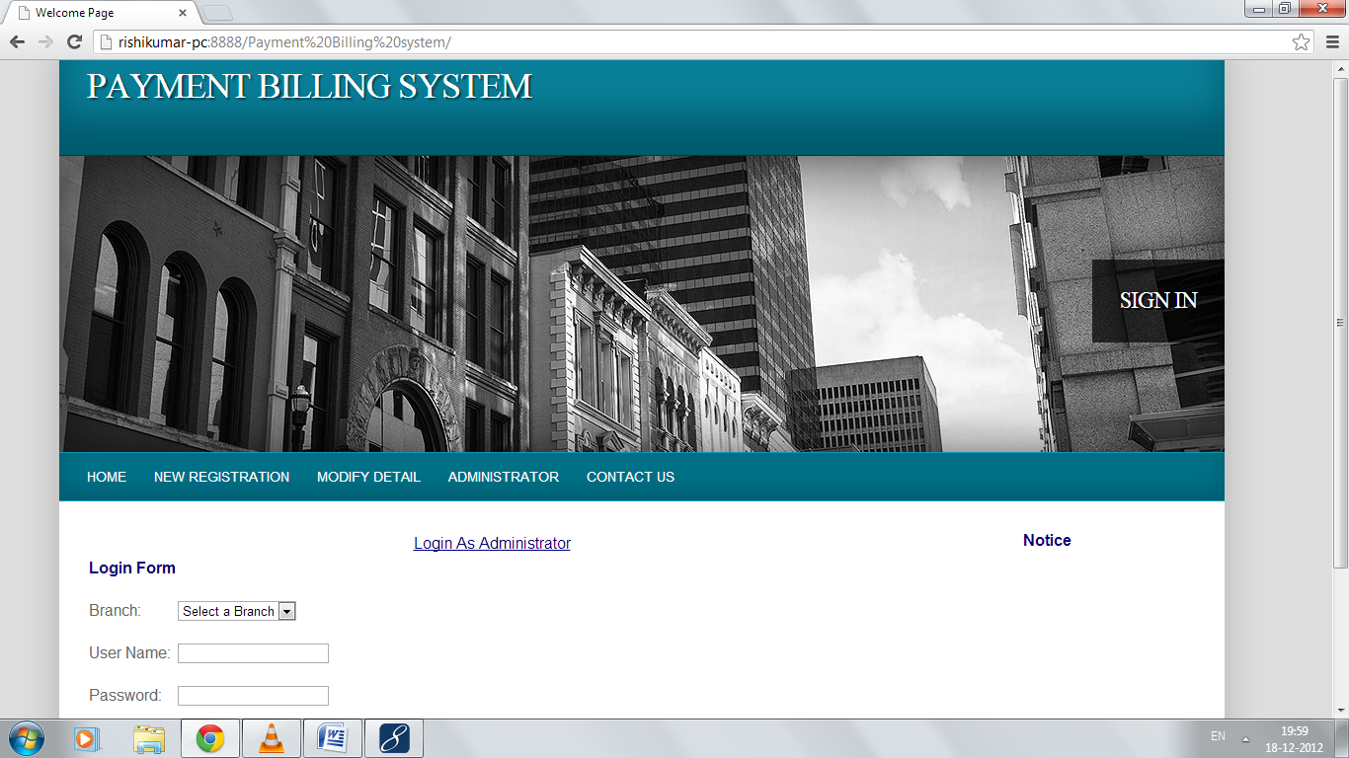
Screenshots:-
Home Page:

Slide 11
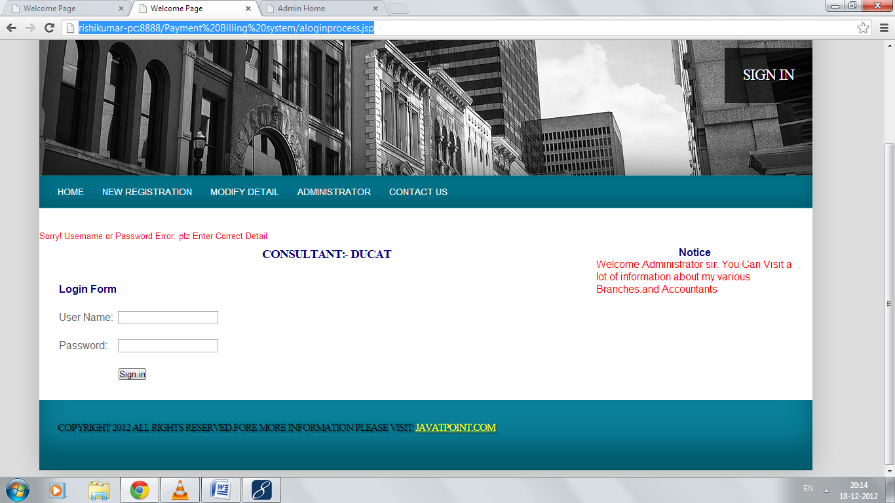
On Filling Incorrect Details:

Slide 12
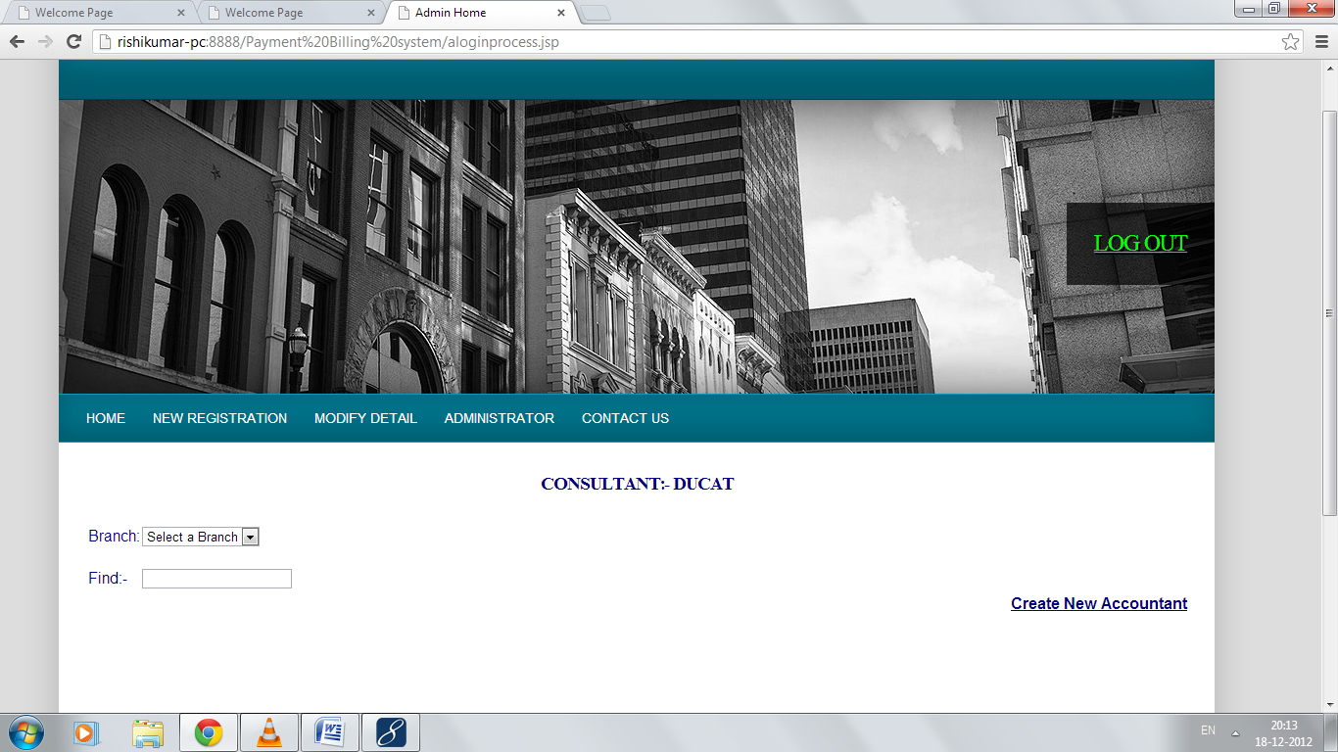
On Filling Correct Details:

Slide 13
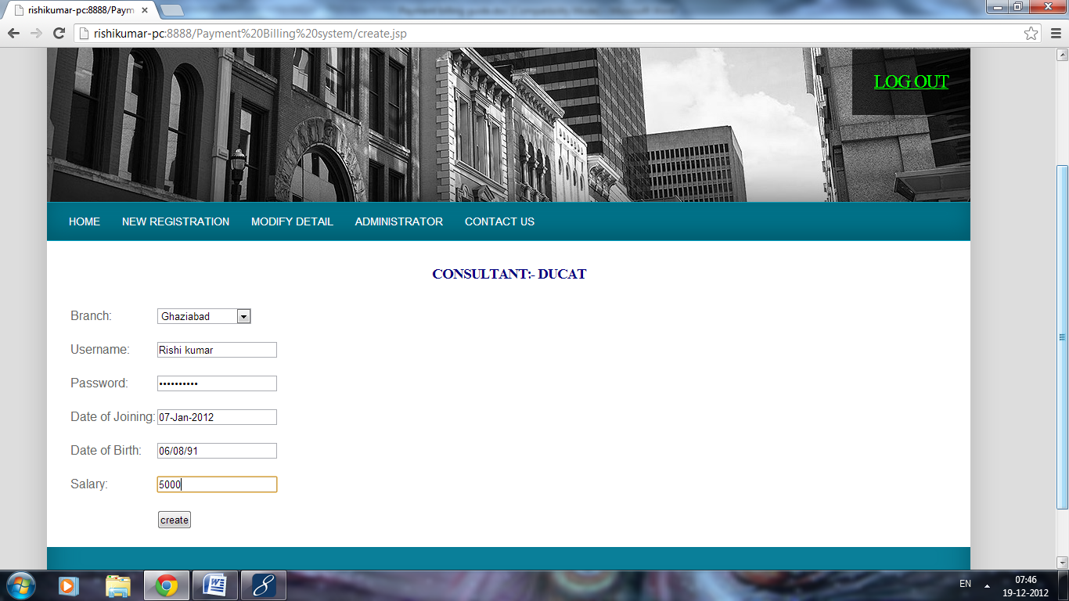
Create new accountant page

Slide 14
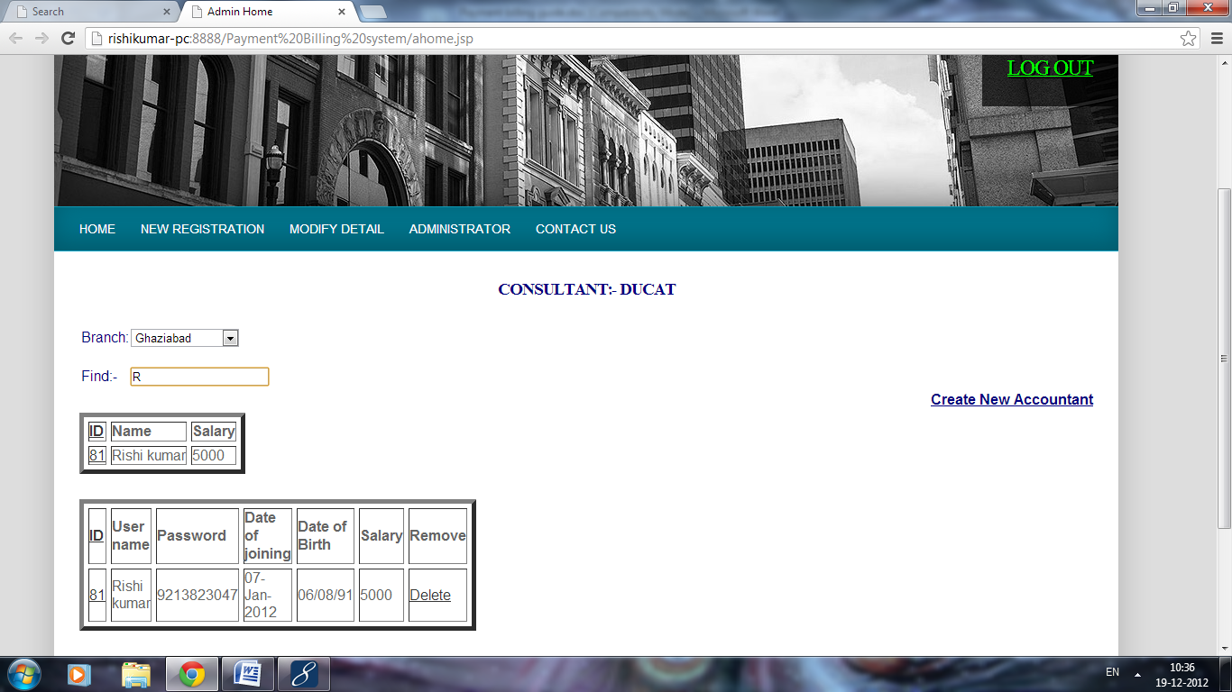
And admin can browse any accountant as follows

Slide 15
After creating accountant each accountant can login through welcome page

Slide 16
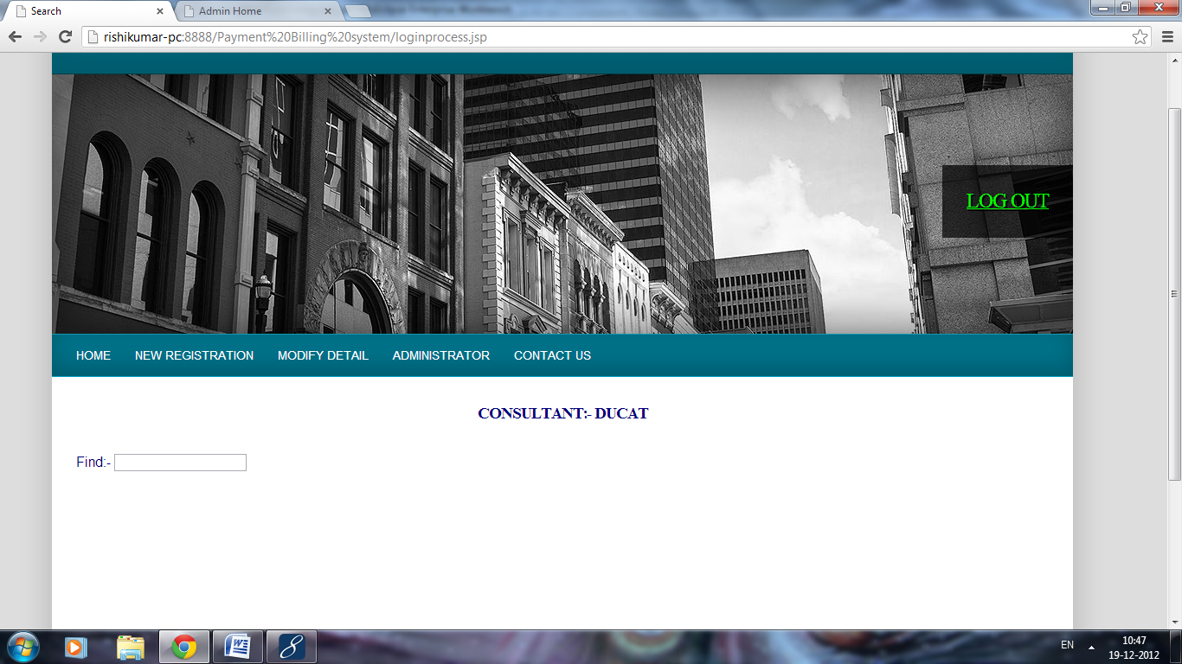
Accountant Login:

Slide 17
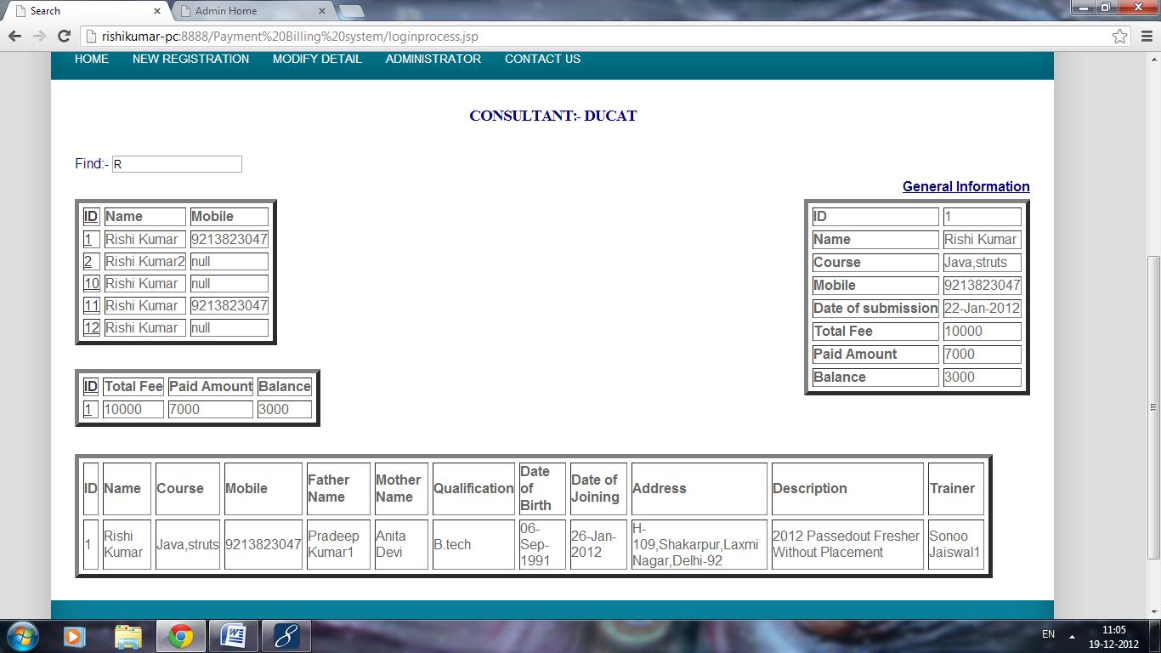
Searching Records

Slide 18
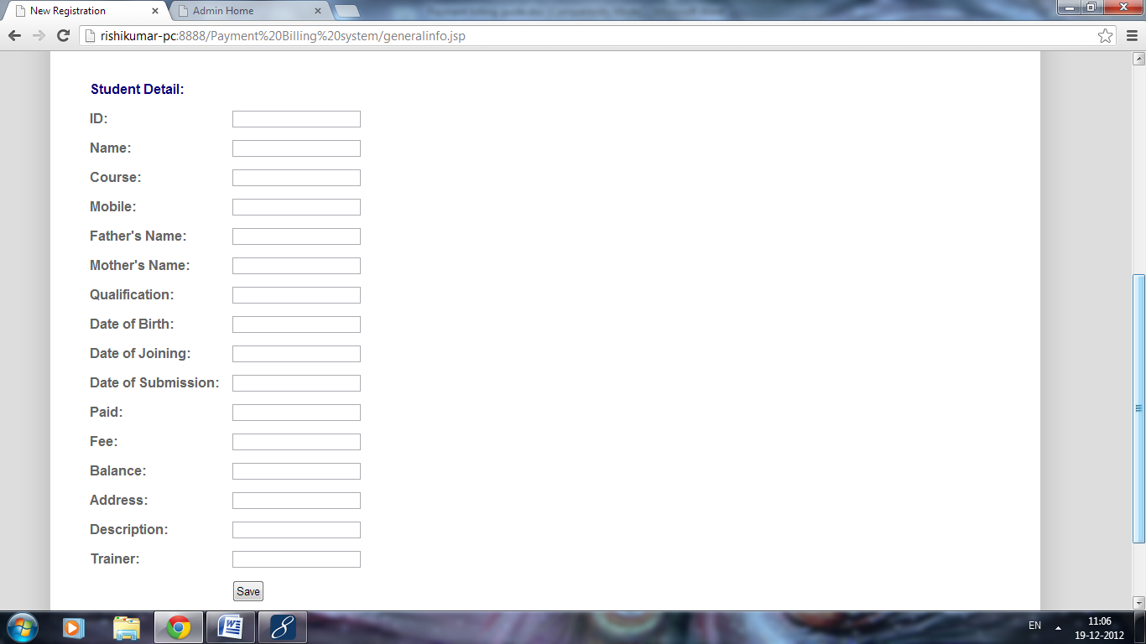
To add new records

Slide 19
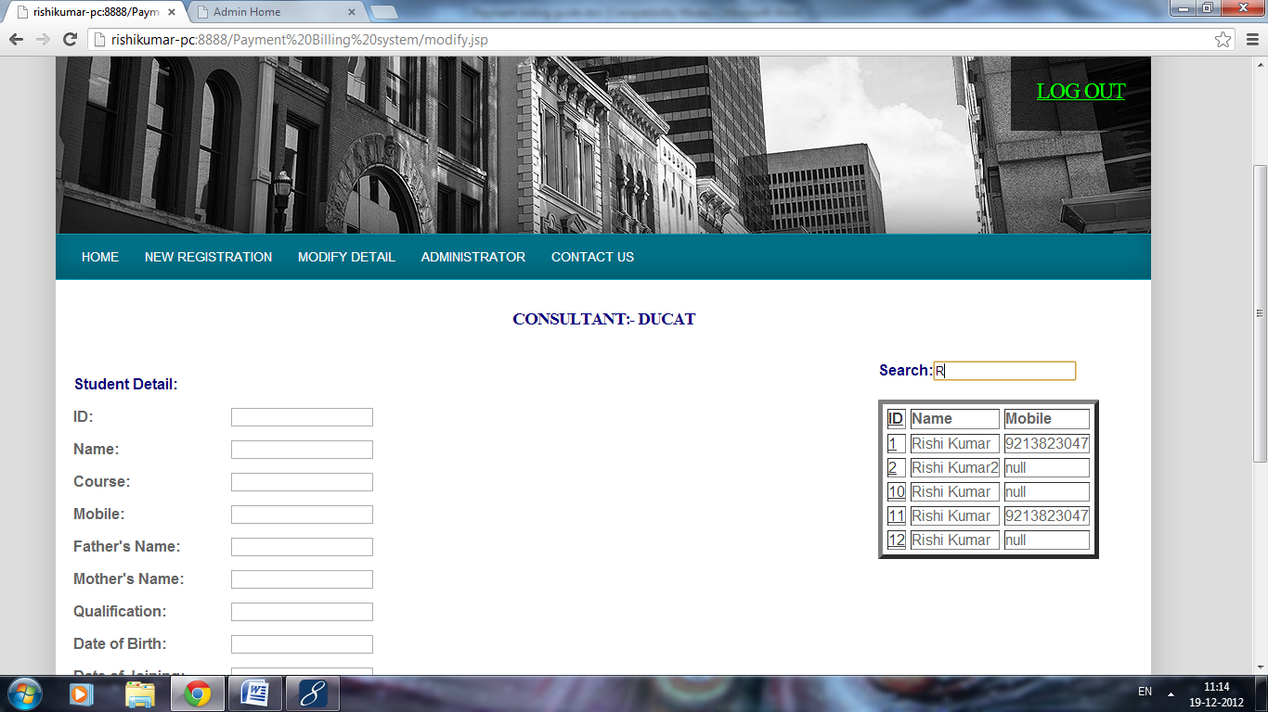
To modify detail first find the record you want to modify it as follows:

Slide 20
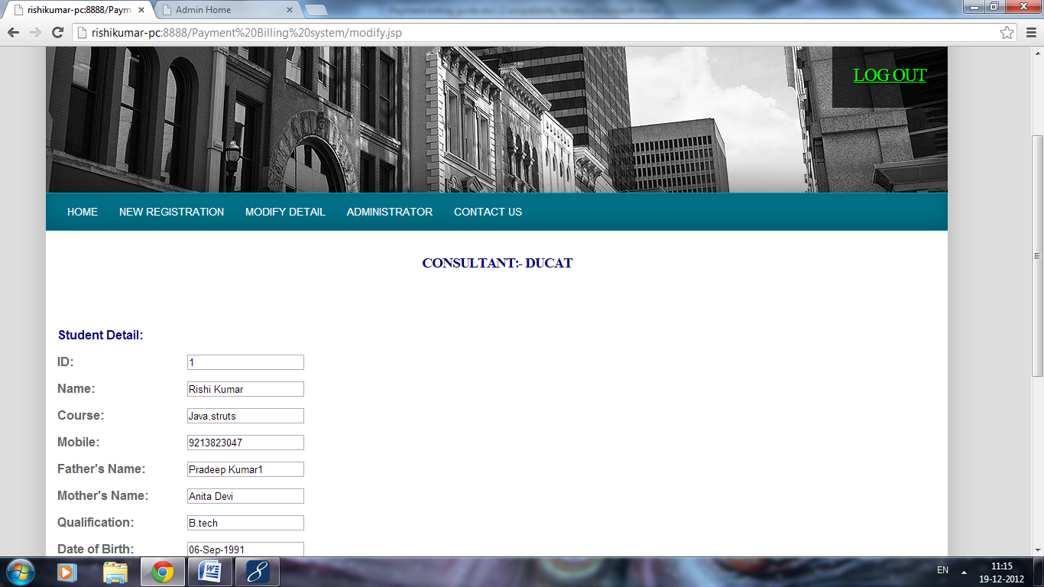
Now point the id of respective row-

Slide 21
Conclusion
Thus by this software we will provide a platform which will facilitate students and teachers to for payment conviniently

